Slide 1









PARKINSON’S FALL DETECTION SYSTEM USING IOT Team-03
Name
FALL DETECTION SYSTEM
Akhila H
Archith K R
Avanthi Anand
Shreeram Bhat
Karthiik S
MENTOR:
Mr. Karthik K Natarajan
Vijesh Srimal

Slide 2
Problem statement
Name
Parkinson’s disease (PD) is a central nervous system disorder that mainly affects the kinetic system in humans due to which there is recurrent occurrence of falls which might even lead to deaths or put them in a serious condition.
In order in solve this problem, we have proposed a system that detects patient’s Fall and reports to the caretaker or family member by means of message/call/Alarm thereby avoiding deaths.

Slide 3
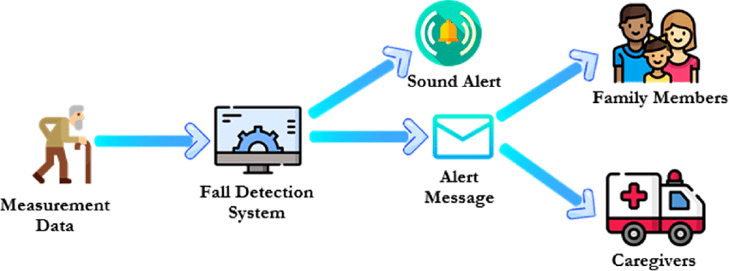
Design
Name

Slide 4
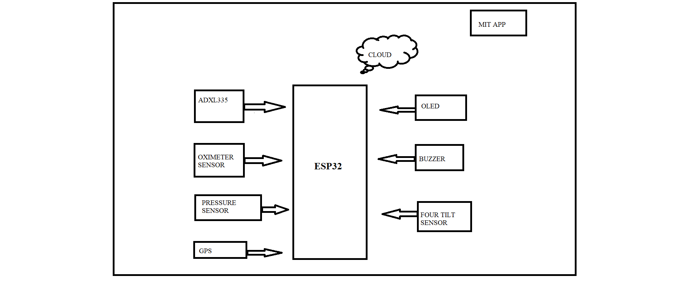
Proposed Methodology/Architecture
Name
The Architecture is consists of a Microcontroller (ESP32), Accelerometer Sensor (ADXL337), Oximeter sensor module (MAX30100), Pressure Sensor(BMP180), tilt sensor, OLED along with the Global Positioning Sensor(GPS).
This system has two main parts.
i. The first part is the sensor-board device. The
ESP32 acts a coordinator to send the
kinematic signal detected to Cloud.
ii. The second major part is the real time data
analytics and data storage system which is
used to record the kinematic signal to cloud
storage.
It also implements ML technique using voice database which helps in early disease detection.

Slide 5
Data processing/Testing
Name
Components Used-
1. Accelerometer
2. ESP32
3. BMP180
4. Global Positioning System
5. MAX30100
6. OLED
7. Buzzer
8. Tilt Sensor
Software Used-
1. Arduino IDE
2. Firebase Cloud
3. MIT Application

Slide 6
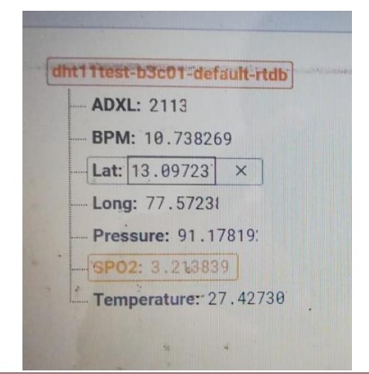
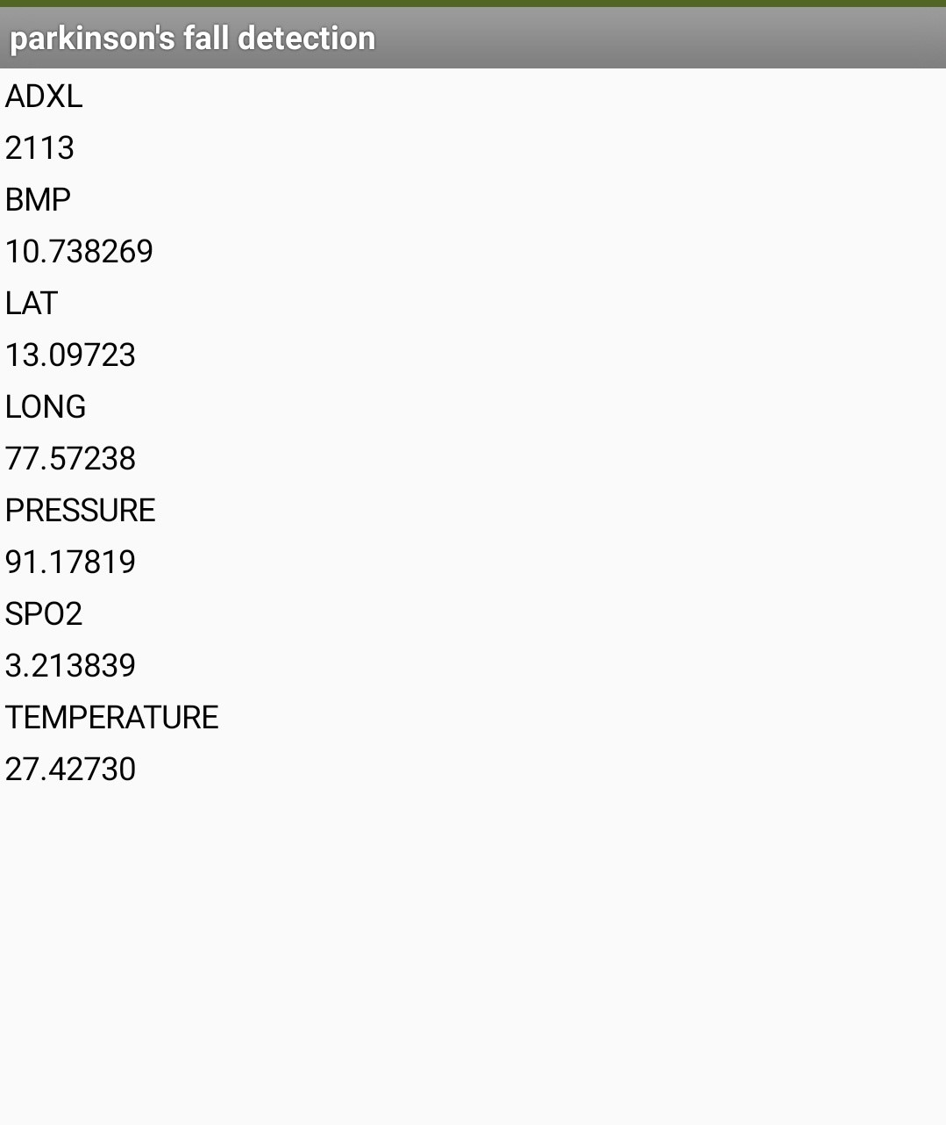
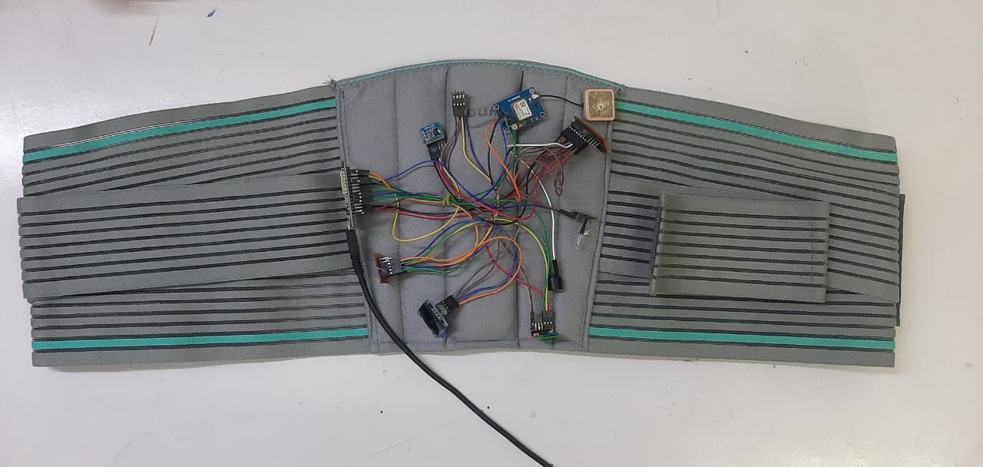
Output/Results
Name
Fig. Prototype
Fig. Parameters stored in firebase Cloud
Fig. MIT Mobile Application

Slide 7
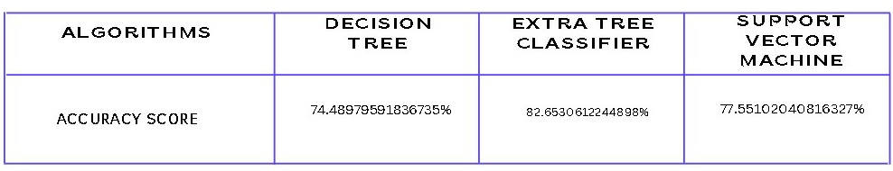
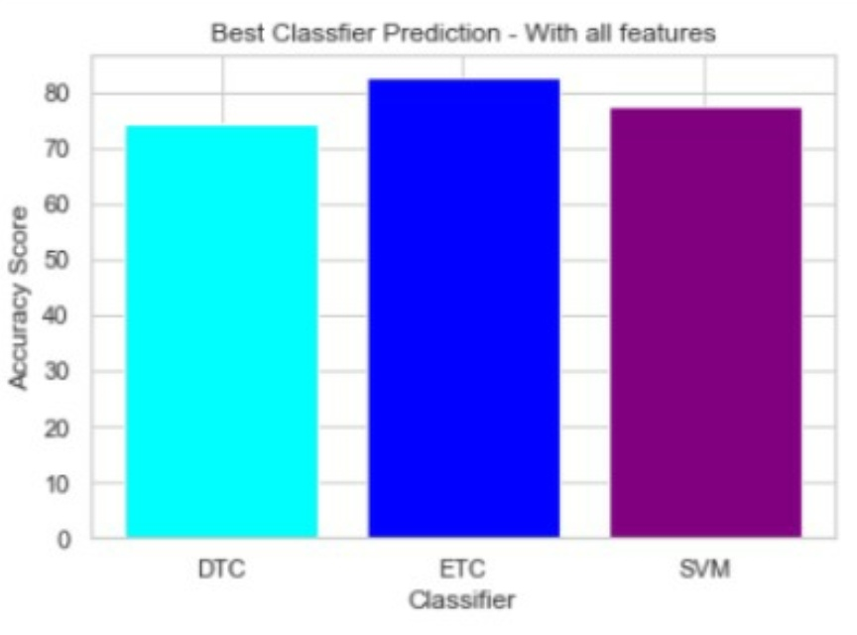
Key Statistics
After evaluation we realized that the Extra Tree Classifier provided a better accuracy of 82.65% with selected features in determining the patients

Slide 8
Conclusion and Innovation
Name
We have developed an intelligent device for detecting falls using the pattern of Parkinson’s patients and we have achieved it using this system.
Our system will not only detect falls but will also send real time data such as body temperature, spo2 and blood pressure. These important medical parameters can be used by the doctors for future patient evaluation.
The real time location update of patients is the most important facility of our system which helps the caretakers and family to reach the patients immediately.

Slide 9
THANK YOU
Name

